Slide 2
WEEKLY NIFTY & BANK NIFTY VIEW
Presented By-Mr. Ratnesh Goyal
(Sr. Technical Analyst)

Slide 3
NIFTY OUTLOOK
if we look at the daily chart of Nifty, we are observing that it is trading near the support level of the 200 SMA, and on the weekly chart, we are observing that it is taking support from the lower channel. If we analyze both charts, it indicates that the market is now taking support from its lower level, and we can see some stock specific action. In the coming trading session, if Nifty trades above the 17,650 level, if it starts to trade above, then it can touch the 17,850-18,050 levels, while on the downside, support is 17,500, and if it starts to trade below then it can test the level of 17,350 and 17,100 levels.

Slide 4
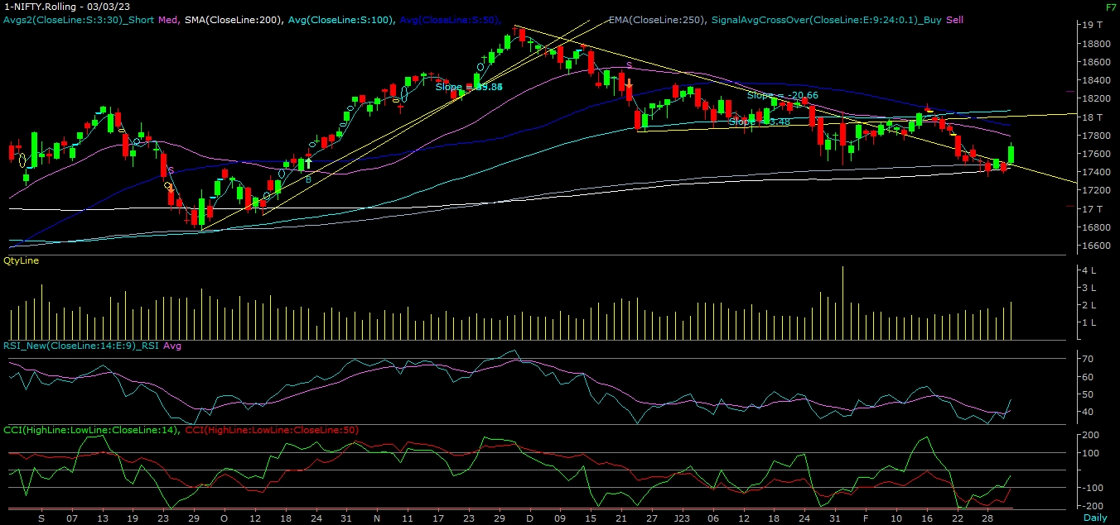
NIFTY

Slide 5
NIFTY BANK OUTLOOK
If we look at the daily chart of Bank-Nifty, we are observing that Bank-Nifty is trading near its 50- DAY SMA level, and on the weekly chart, we are observing "BULLISH" candlestick formation. If we analyse both charts, it indicates that the banknifty can outperform the nifty. In the coming trading session, if it trades above 41,350, then it can touch 41,600 and 41,800 levels. However, downside support comes at 40,900, and below that we can see 40,700–40,400 levels.

Slide 6
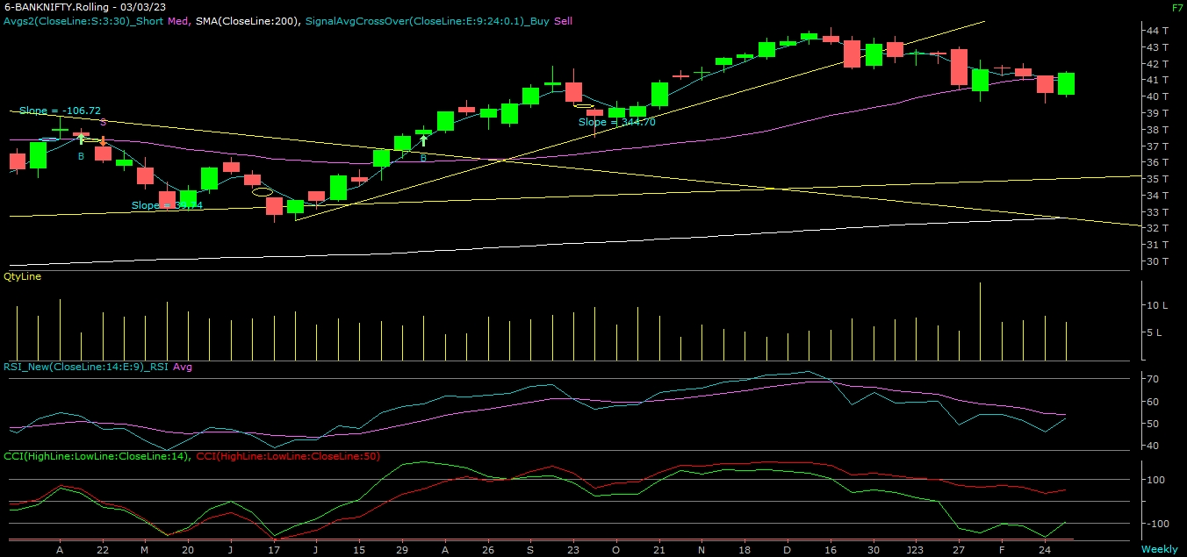
BANK NIFTY

Slide 7
FINAL SUMMARY
NIFTY BANK NIFTY Resistance – 17850-18050 Resistance – 41600 - 41800
Support – 17350-17100 Support – 40700 - 40400

