Slide 2
WEEKLY NIFTY & BANK NIFTY VIEW
Presented By-Mr. Ratnesh Goyal
(Sr. Technical Analyst)

Slide 3
NIFTY OUTLOOK
If we look at the technical chart of Nifty we are observing that nifty has been broke the 50SMA and on weekly chart it has been broke the lower trend line support level. It indicate we may see some pressure from the higher level in the market. Nifty can face resistance around 17,950 level if it start trade above then it can touch 18,100-18,300 levels, while on the downside support is 17,750 if it start trade below then it can test the level of 17,550 and 17,300 levels.

Slide 4
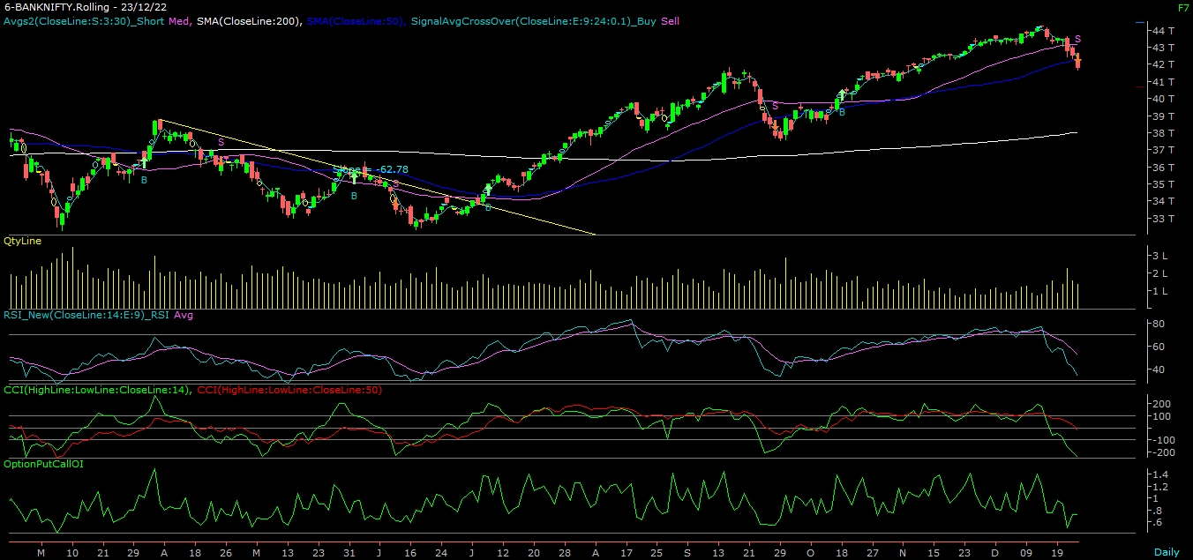
NIFTY

Slide 5
NIFTY BANK OUTLOOK
If we look at the daily chart of Bank-Nifty we are observing that it also have been broke the 50SMA and in weekly chart it has been broke the lower trend line. If we analyzed both chart then it seems that we can see pressure from the higher level in the coming trading session if it trade above 41,850 then it can touch 42,200 and 42,500 levels, however downside support comes at 41,500 below that we can see 41,100-40,500 levels.

Slide 6
BANK NIFTY

Slide 7
FINAL SUMMARY
NIFTY BANK NIFTY Resistance – 18100-18300 Resistance – 42200 - 42500
Support – 17550-17300 Support – 41100 - 40500

