Slide 2
WEEKLY NIFTY & BANK NIFTY VIEW
Presented By-Mr. Ratnesh Goyal
(Sr. Technical Analyst)

Slide 3
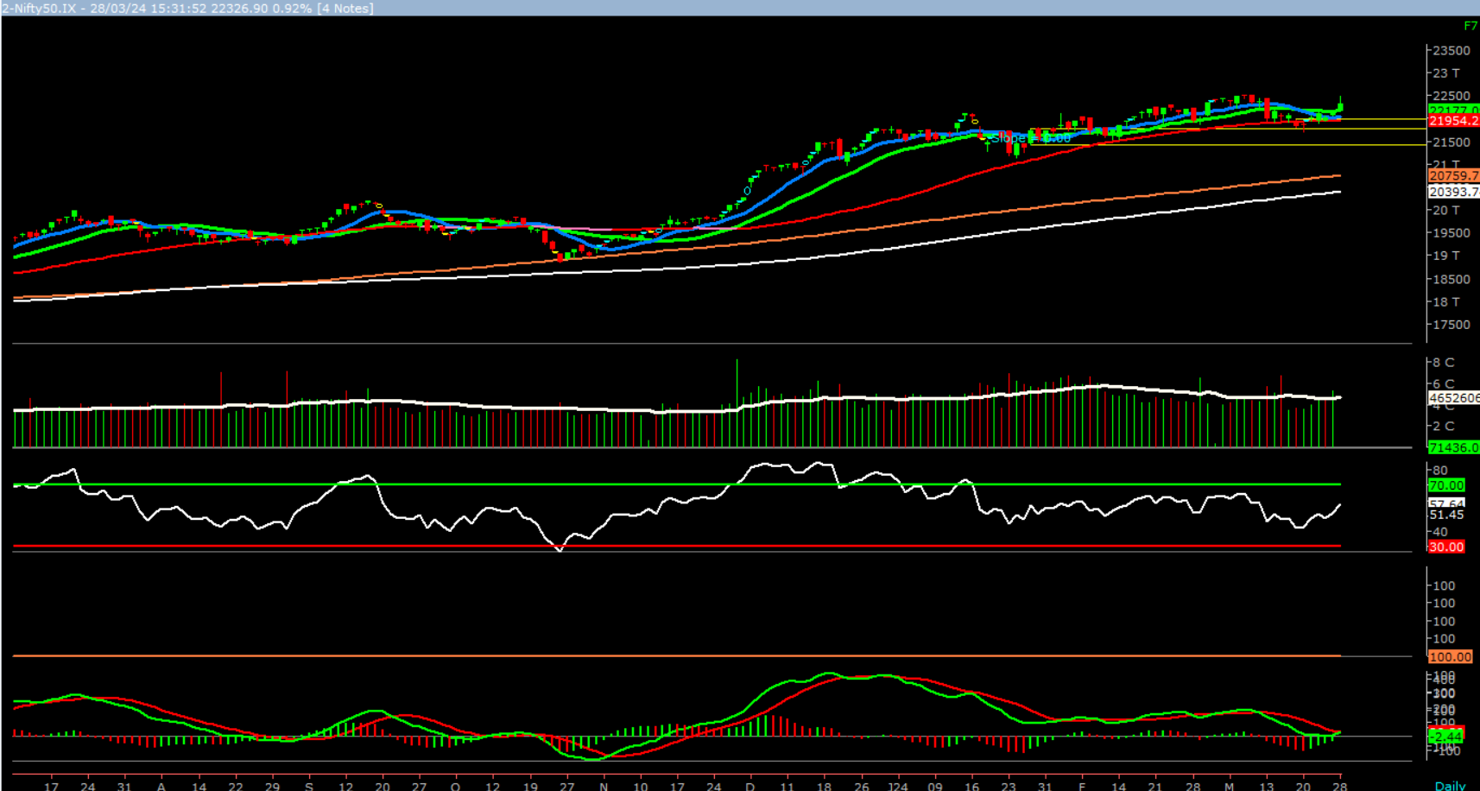
NIFTY

Slide 4
NIFTY OUTLOOK
On the daily chart, we are observing that prices have convincingly reclaimed the 20-days SMA (22177). This suggests that the undertone in the market has turned positive and momentum on the upside is likely to continue. In coming week, if nifty trades above 22380 levels then it may test 22525 - 22680 level. On the downside, 22177 – 21900 may act support for the week.

Slide 5
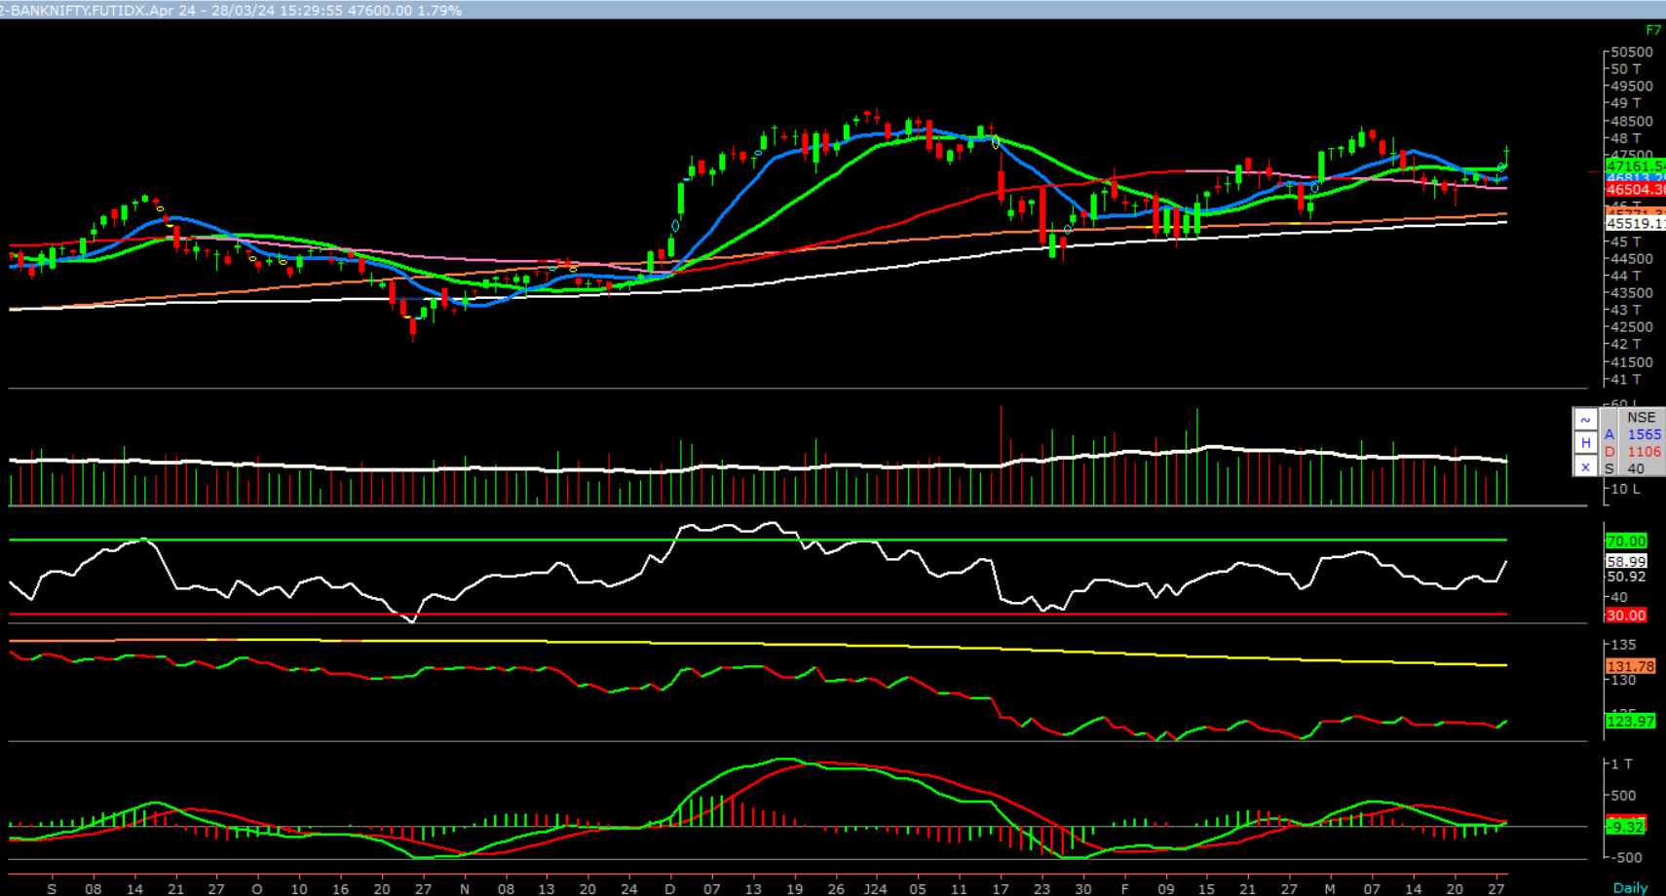
BANK NIFTY

Slide 6
NIFTY BANK OUTLOOK
On the daily chart of Bank-Nifty, we are observing an upward gap area in the range of 46960 – 47264. Normally upward gap area does act as support for the prices. Further, prices have started trading well above the 10&20 days SMA (46813 – 47161). This clearly suggest that momentum on the upside is likely to continue. In coming week if Bank-nifty trades above 47700 then it likely to test 48,300 and 48,750 levels. On downside, 47161 – 46813 levels may act as support for the week.

Slide 7
FINAL SUMMARY
NIFTY BANK NIFTY Resistance – 22525-22680 Resistance – 48300 - 48750
Support – 22177- 21900 Support – 47131 - 46813

