Slide 2
WEEKLY NIFTY & BANK NIFTY VIEW
Presented By-Mr. Ratnesh Goyal
(Sr. Technical Analyst)

Slide 3
NIFTY OUTLOOK
If we look at the daily chart of Nifty, we are observing “Doji” candlestick formation and “Downward gap area” and on the weekly chart we are observing prices trading above “Short-term moving averages, If we analyze both chart patterns it indicates, stocks specific action will remain continue and adopt buying on deep strategy. if Nifty starts trading above the 22,600 level, then it can touch the 22,800-22,950 level, while on the downside, support is 22,450 and if it starts to trade below then it can test the level 22,300 and 22,100 levels.

Slide 4
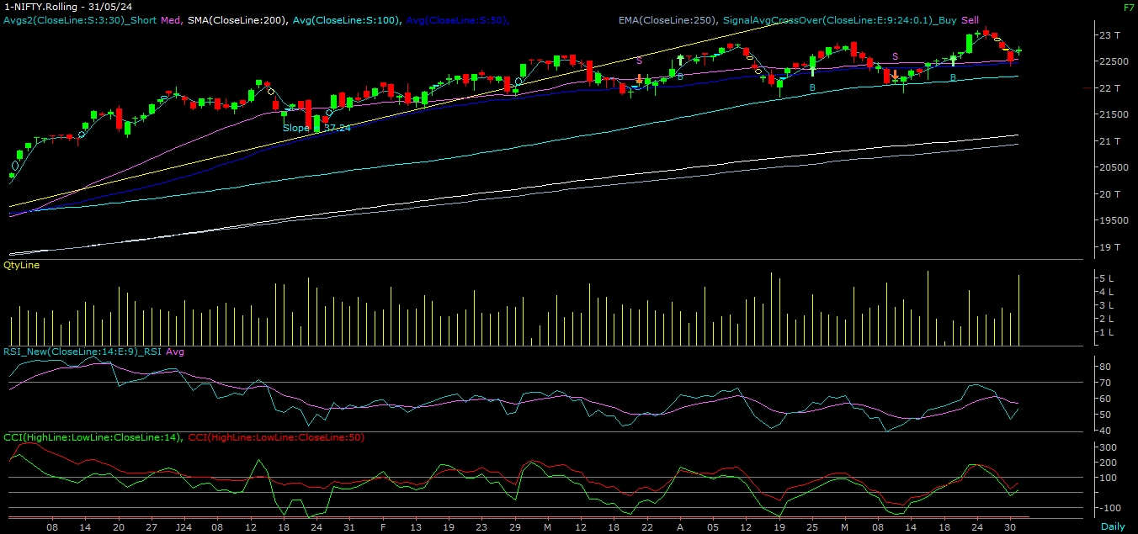
NIFTY

Slide 5
NIFTY BANK OUTLOOK
If we look at the daily chart of Bank-Nifty, we are observing a "Hammer” candlestick formation & on the weekly chart “Doji” candlestick formation, if we analyze both chart patterns it indicates Bank-nifty will also be volatile, but from a lower level, we can see recovery in the market. Bank-nifty starts trades above 49,100 then it can touch 49,450 and 49,700 levels. However, downside support comes at 48,800, and below that, we can see 48,400 and 48,150 levels.

Slide 6
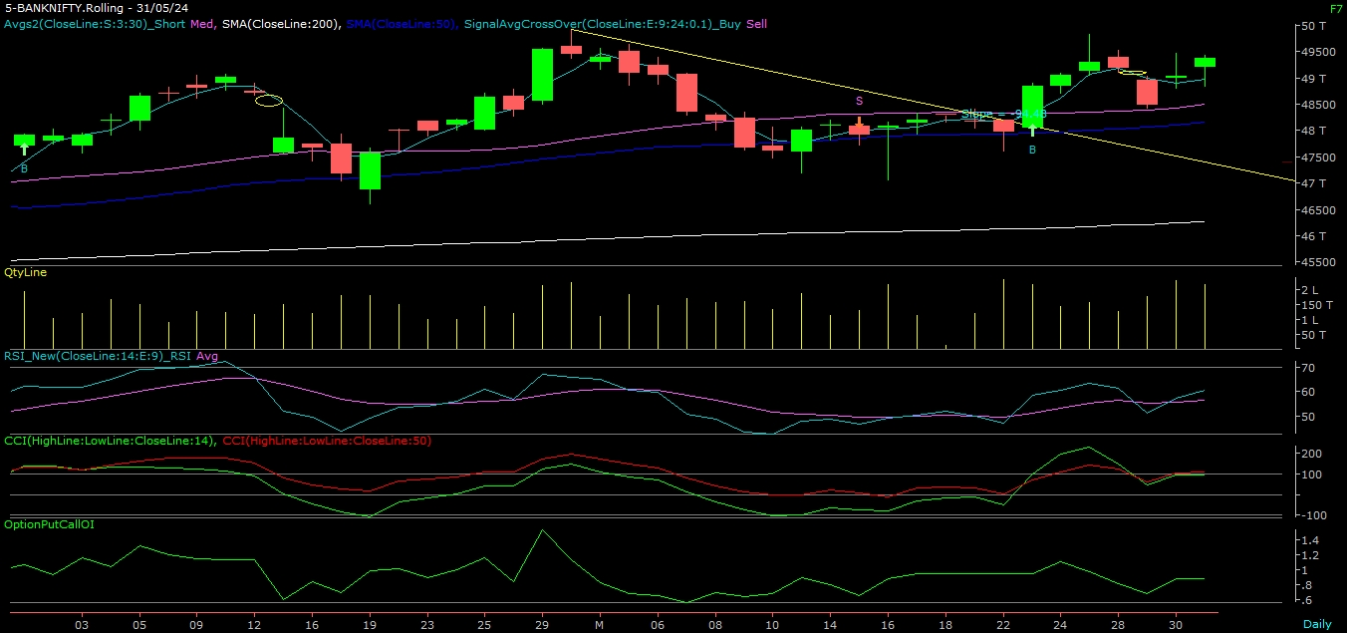
BANK NIFTY

Slide 7
FINAL SUMMARY
NIFTY BANK NIFTY Resistance – 22800-22950 Resistance – 49450 - 49700
Support – 22300-22100 Support – 48400 - 48150

