Slide 1



Slide 2

WEEKLY NIFTY & BANK NIFTY VIEW
Presented By-Mr. Ratnesh Goyal
(Sr. Technical Analyst)

Slide 3

NIFTY OUTLOOK
If we look at the daily as well as weekly chart of Nifty we are observing a “Series of Narrow range body formation” If we analyze both chart patterns it indicates we will remain in consolidation and buy on dips will continue with stock-specific action. if Nifty starts trading above the 22,550 level, then it can touch the 22,650-22,750 level, while on the downside, support is 22,450 and if it starts to trade below then it can test the level 22,350 and 22,200 levels.

Slide 4
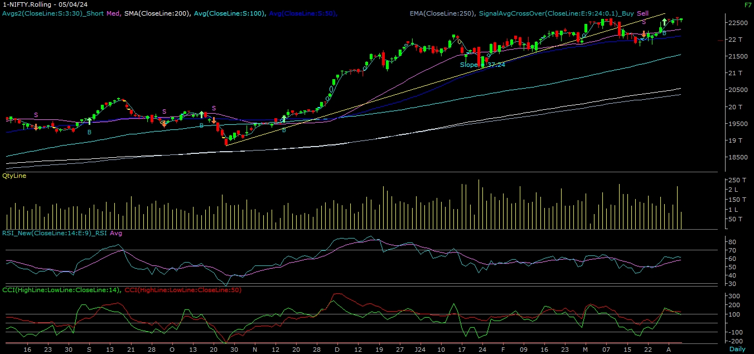
NIFTY

Slide 5
NIFTY BANK OUTLOOK
If we look at the daily chart of Bank-Nifty, we are observing “Rounding formation” and on weekly chart trading above “Short-term term “ moving averages, if we analyze both chart patterns it indicates Bank-nifty can outperform Nifty. Bank-nifty starts trades above 48,550 then it can touch 48,700 and 48,850 levels. However, downside support comes at 48,300, and below that, we can see 48,100 and 47,800 levels.

Slide 6
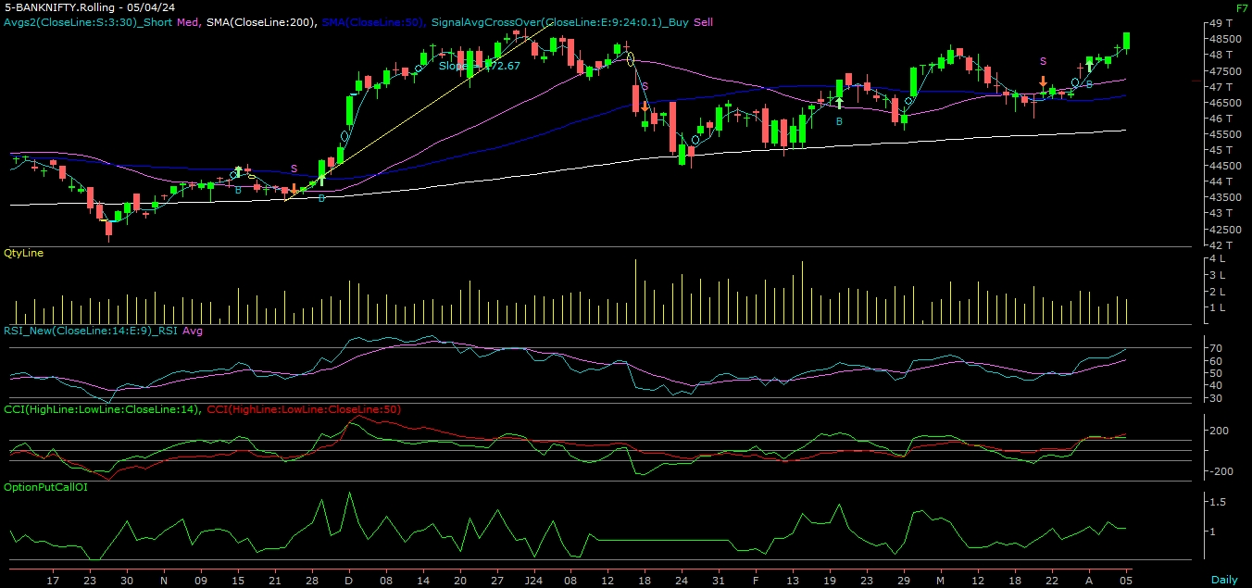
BANK NIFTY

Slide 7
FINAL SUMMARY
NIFTY BANK NIFTY
Resistance – 22650-22750 Resistance – 48700 - 48850
Support – 22350-22200 Support – 48100 - 47800

