Slide 2
WEEKLY NIFTY & BANK NIFTY VIEW
Presented By-Mr. Ratnesh Goyal
(Sr. Technical Analyst)

Slide 3
NIFTY OUTLOOK
If we look at the daily chart of Nifty, we are observing prices tested “Downward gap area” and “Bullish Harami” pattern and on the weekly chart we are observing “Long leg Doji” candlestick formation, If we analyze both chart pattern it indicates after decent fall now, we may see stocks specific action will remain to continue and adopt buying on deep strategy. if Nifty starts trading above the 23,325 level, then it can touch the 23,550-23,700 level, while on the downside, support is 23,150 and if it starts to trade below then it can test the level 22,900 and 22,650 levels.

Slide 4
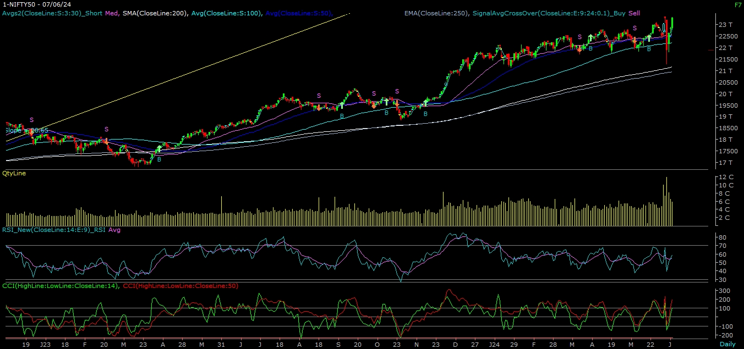
NIFTY

Slide 5
NIFTY BANK OUTLOOK
If we look at the daily chart of Bank-Nifty, we are observing "Hammer” candlestick formation & prices trading above 50 Day SMA & on the weekly chart “ Long leg Doji” candlestick formation, if we analyze both chart patterns it indicates Bank-nifty can trade with positive bias & use buy on deep strategy. Bank-nifty start trading above 49,950 then it can touch 50,150 and 50,500 levels. However, downside support comes at 49,600, and below that, we can see 49,100 and 48,800 levels.

Slide 6
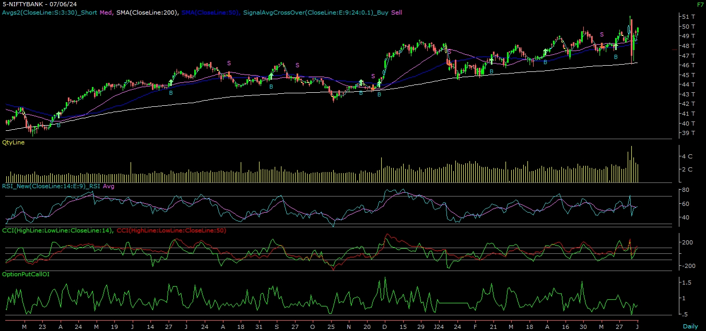
BANK NIFTY

Slide 7
FINAL SUMMARY
NIFTY BANK NIFTY Resistance – 23550-23700 Resistance – 50150 - 50500
Support – 22900-22650 Support – 49100 - 48800

