Slide 1



Slide 2

WEEKLY NIFTY & BANK NIFTY VIEW
Presented By-Mr. Ratnesh Goyal
(Sr. Technical Analyst)

Slide 3

NIFTY OUTLOOK
If we look at the daily chart of Nifty we are observing “Narrow range body formation” and on the weekly chart of Nifty, we are observing prices taking support “Upward Trendline”, If we analyze both chart pattern it indicate we may see stock specific action and still use any correction as a buying opportunity. if Nifty starts trading above the 22,080 level, then it can touch the 22150-22200 level, while on the downside, support is 21,900 and if it starts to trade below then it can test the level 21,750 and 21,600 levels.

Slide 4
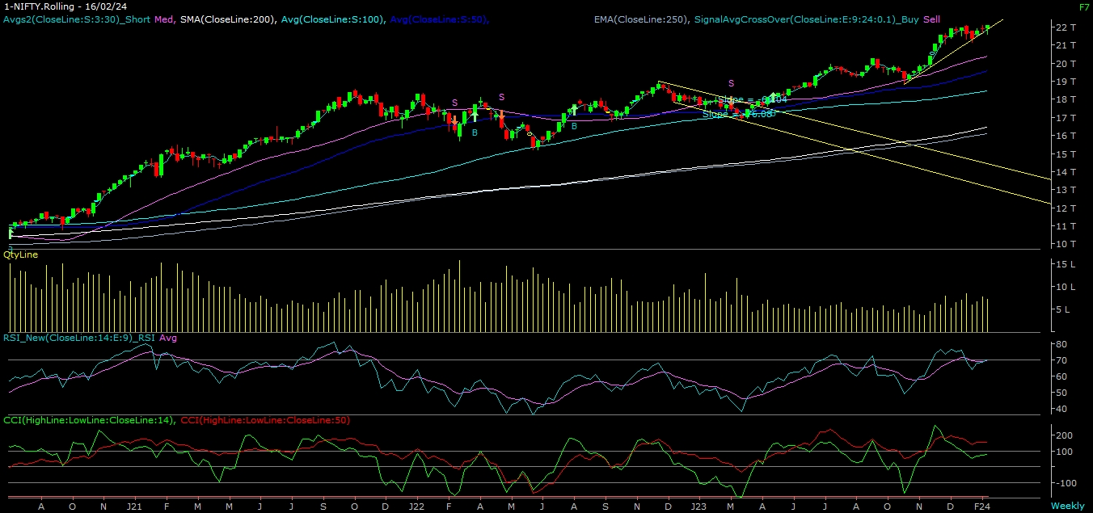
NIFTY

Slide 5
NIFTY BANK OUTLOOK
If we look at the daily chart of Bank-Nifty, we are observing prices facing resistance around short-term moving averages (50 DAY), and on the weekly chart we are observing a “Hammer” candlestick formation, if we analyze both chart patterns it indicates Bank-nifty can outperform Nifty. Bank-nifty starts trades above 46,500 then it can touch 46,750 and 46,900 levels. However, downside support comes at 46,100, and below that, we can see 45,800 and 45,600 levels.

Slide 6
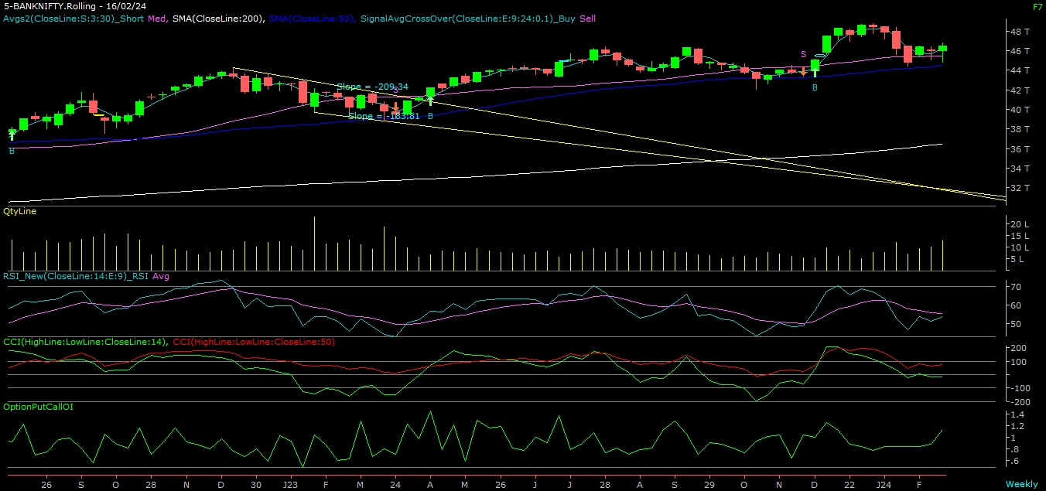
BANK NIFTY

Slide 7
FINAL SUMMARY
NIFTY BANK NIFTY
Resistance – 22150-22200 Resistance – 46750 - 46900
Support – 21750-21600 Support – 45800 - 45600

