Slide 1



Slide 2

WEEKLY NIFTY & BANK NIFTY VIEW
Presented By-Mr. Ratnesh Goyal
(Sr. Technical Analyst)

Slide 3

NIFTY OUTLOOK
If we look at the daily chart of Nifty we observe prices have taken support at “Short-term term moving averages” and on the weekly chart of Nifty, we are “Narrow range body formation" If we analyze both chart pattern it indicate we may see stock specific action and still use any correction as a buying opportunity. if Nifty starts trading above the 22,250 level, then it can touch the 22350-22500 level, while on the downside, support is 22,050 and if it starts to trade below then it can test the level 21,850 and 21,600 levels.

Slide 4
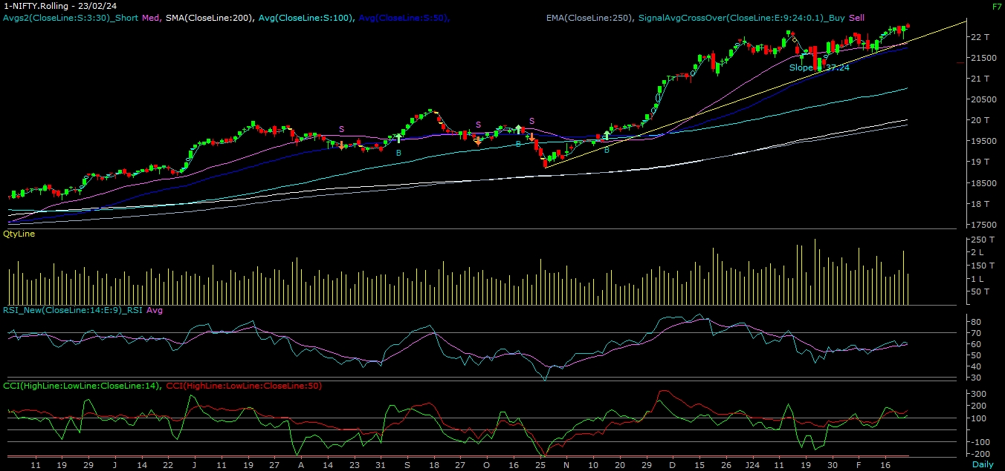
NIFTY

Slide 5
NIFTY BANK OUTLOOK
If we look at the daily chart of Bank-Nifty, we are observing prices trading below 50 Day SMA and on weekly chart we are observing “Narrow range body” formation, if we analyze both chart pattern it indicate Bank-nifty can consolidate. Bank-nifty if start trades above 47,100 then it can touch 47,400 and 47,800 levels. However, downside support comes at 46,500 and below that, we can see 46,100 and 45,800 levels.

Slide 6
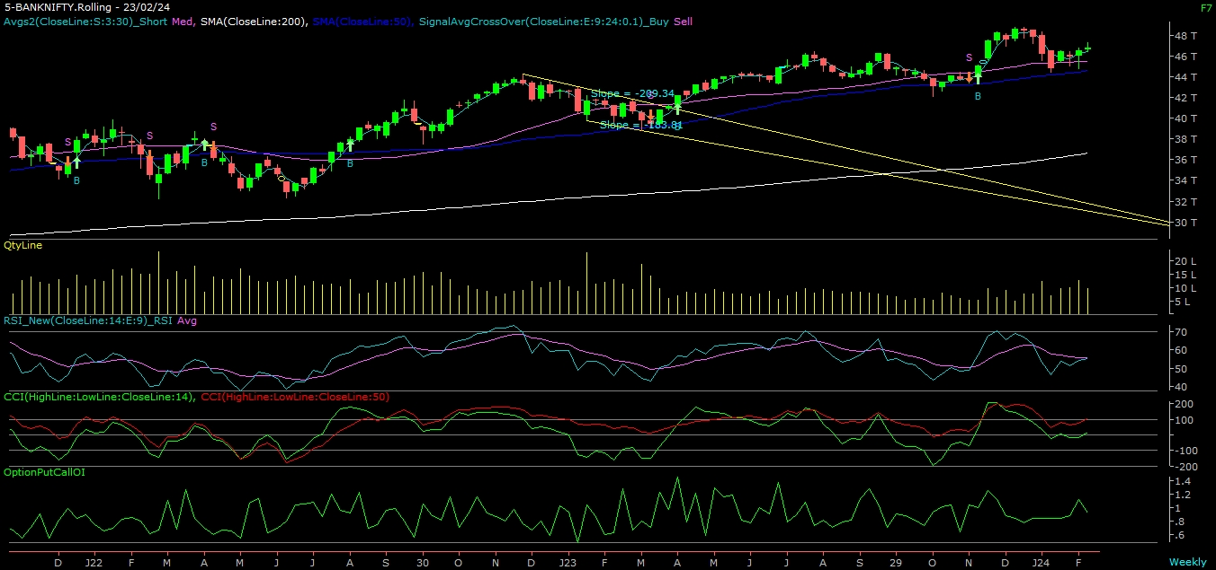
BANK NIFTY

Slide 7
FINAL SUMMARY
NIFTY BANK NIFTY
Resistance – 22350-22500 Resistance – 47400 - 47800
Support – 21850-21600 Support – 46100 - 45800

